Slide 1

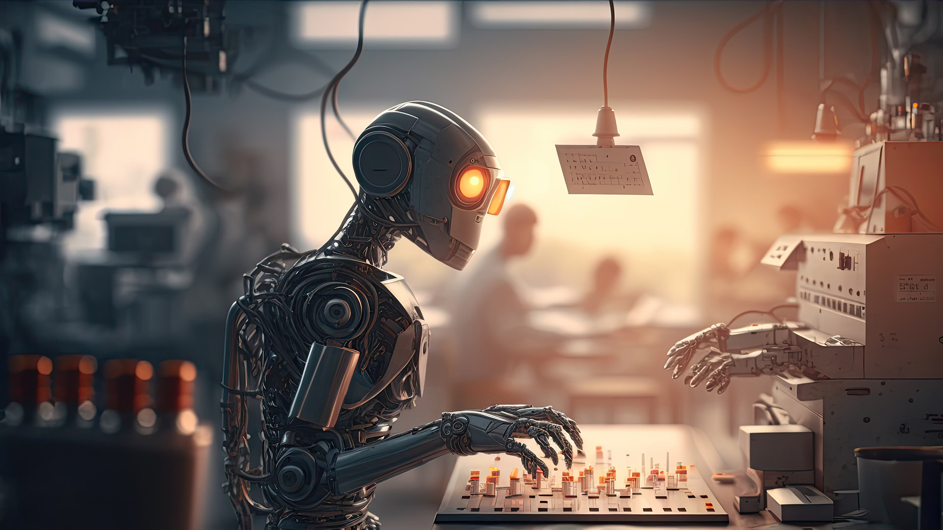



Semi-automated squash refereeing system using computer vision and machine learning
Project proposal

Slide 2


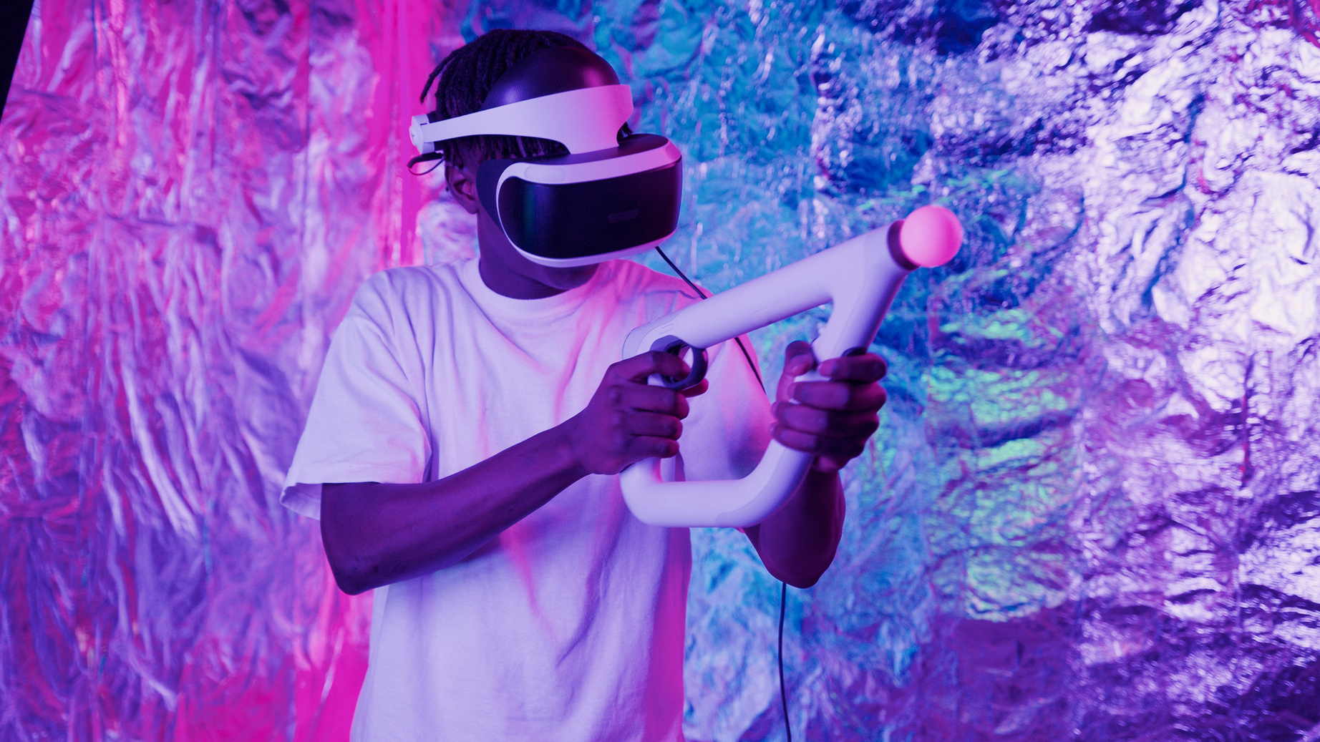
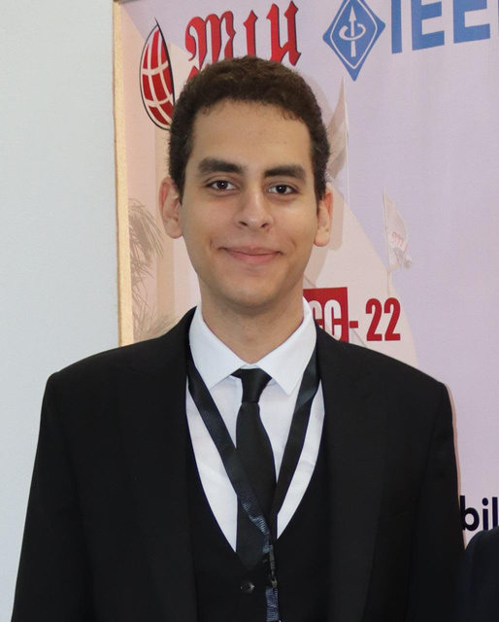
Team
Ahmed Mohamed Said
Hussien Amr Talaat
Seif Nasser
Youssef Mohamed
2020/10587
2020/00770
2020/02058
2020/02130
Team Leader

Slide 3

Introduction
With 20 million players worldwide in over 185 countries, squash is considered one of the most famous sports in the world.
The need for an advanced refereeing system has emerged to reduce human error and improve the overall squash experience.
Our project aims to develop a functional squash system that uses computer vision and machine learning to autonomously and accurately officiate in real time.
The system hopes to ensure fair and consistent decisions, revolutionize playing and watching squash, and embrace technological innovation.

Slide 4
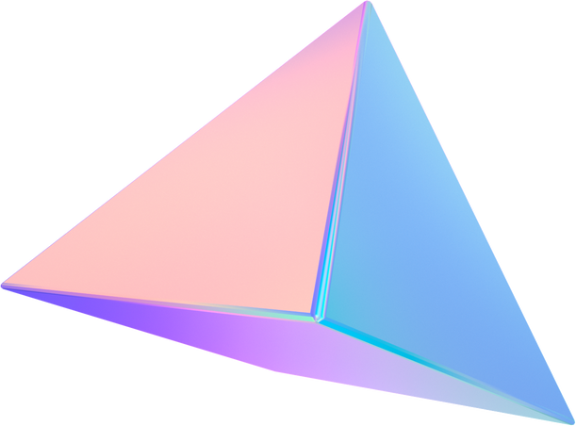


Motivation
This project aims to fill a research gap in squash refereeing systems using computer vision and machine learning. Also, we’re the first researchers to add Artificial intelligence to the refereeing system of the game.
Academic
This project fulfills squash refereeing needs with a semi-automated system, meeting market demands for fair competition and improved viewing. It attracts investments, positions squash as a leader in sports technology, and ensures success for the 2028 Olympics.
Business

Slide 5

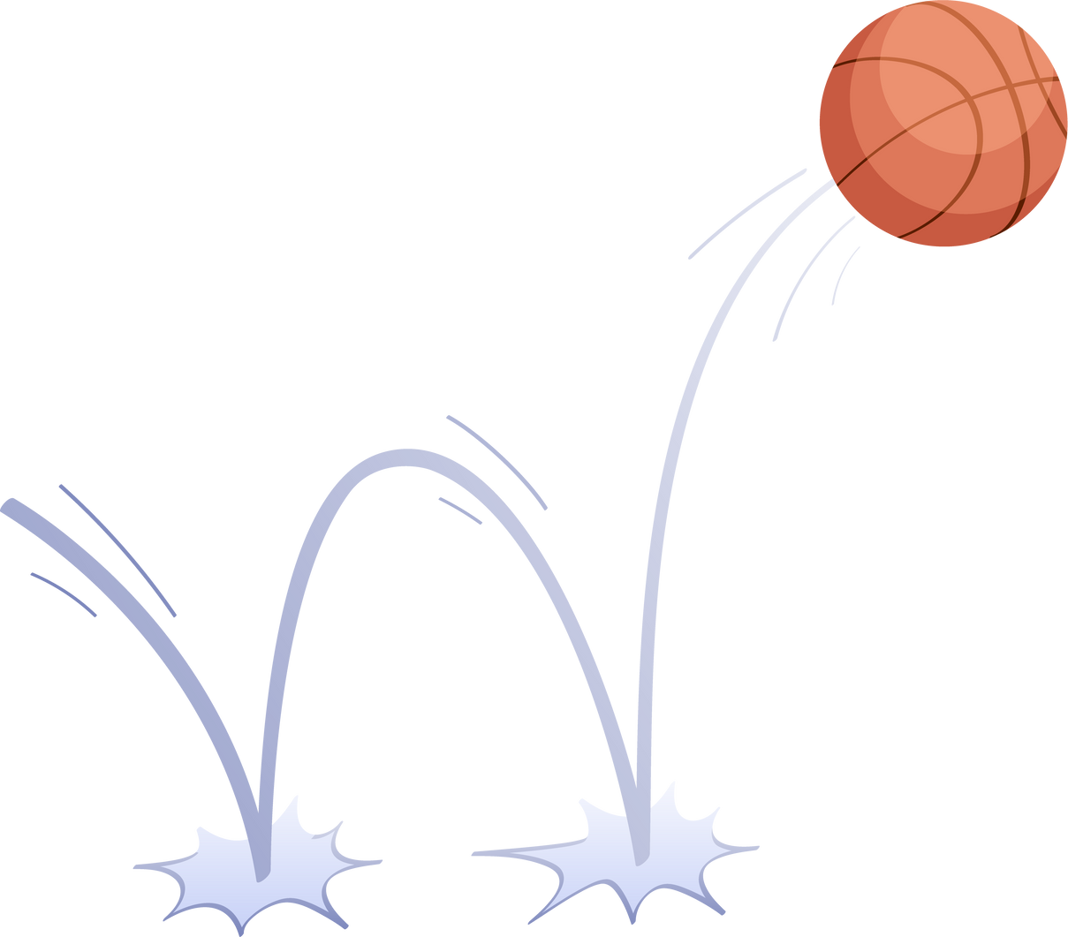
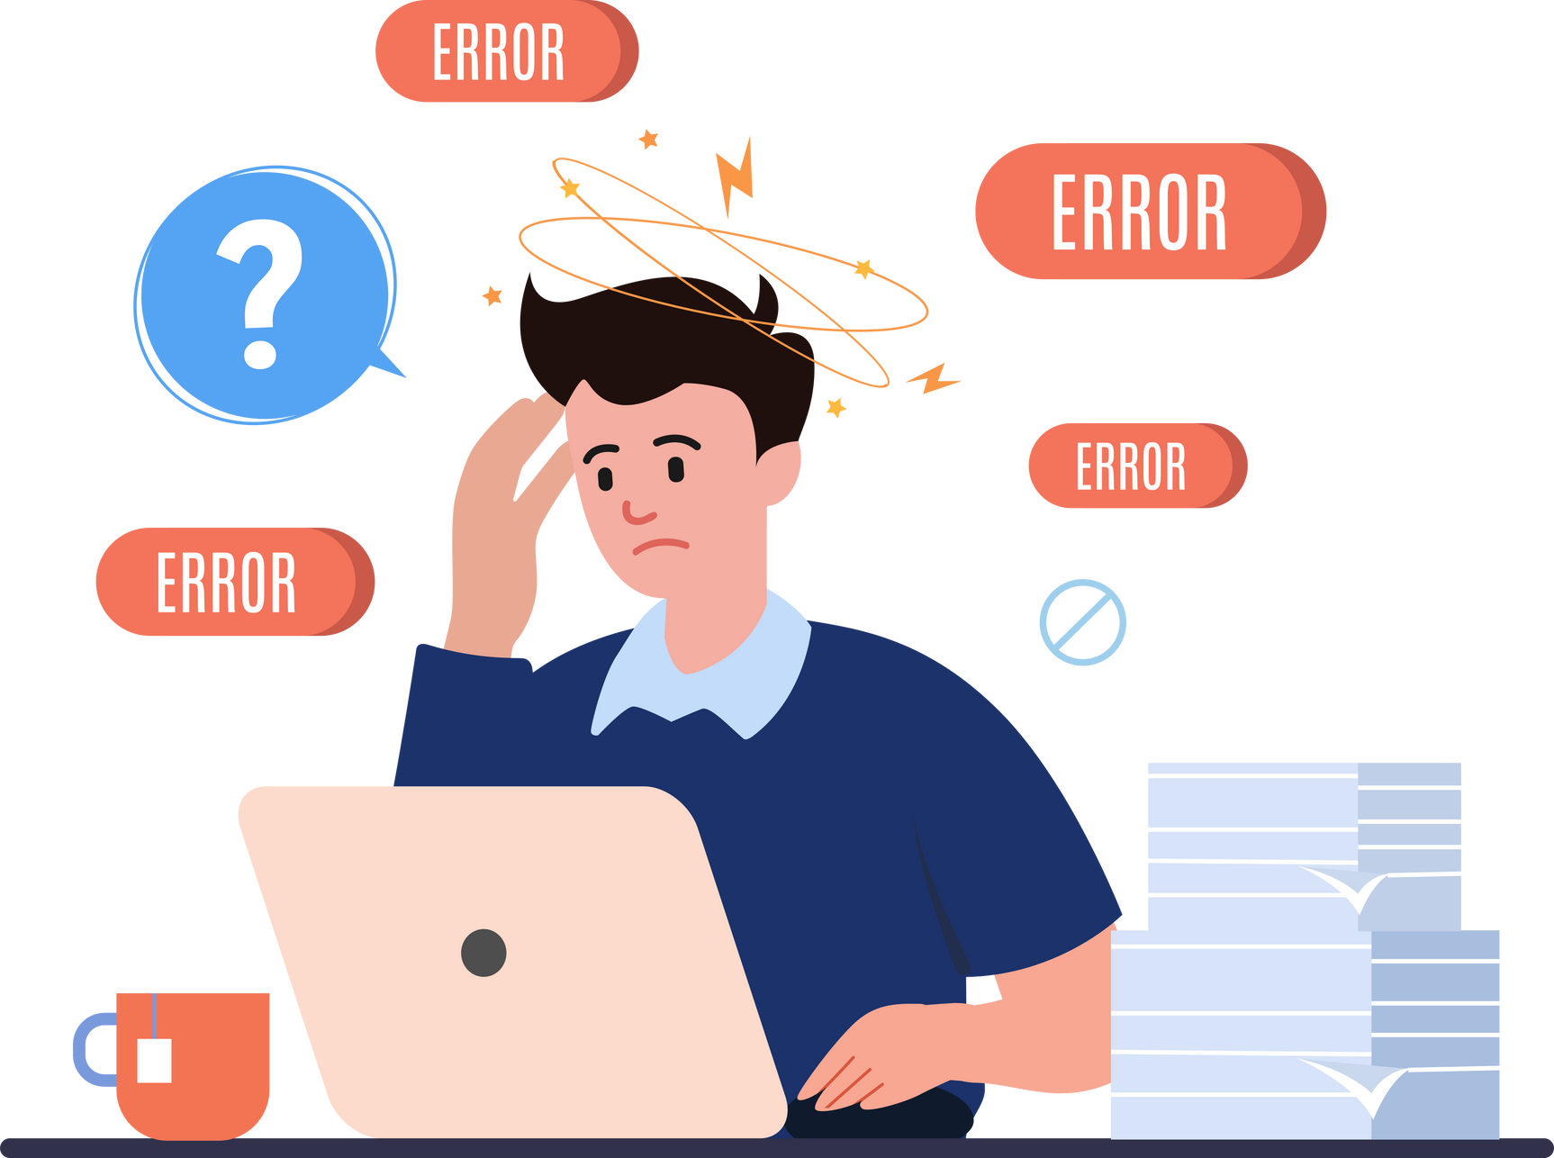
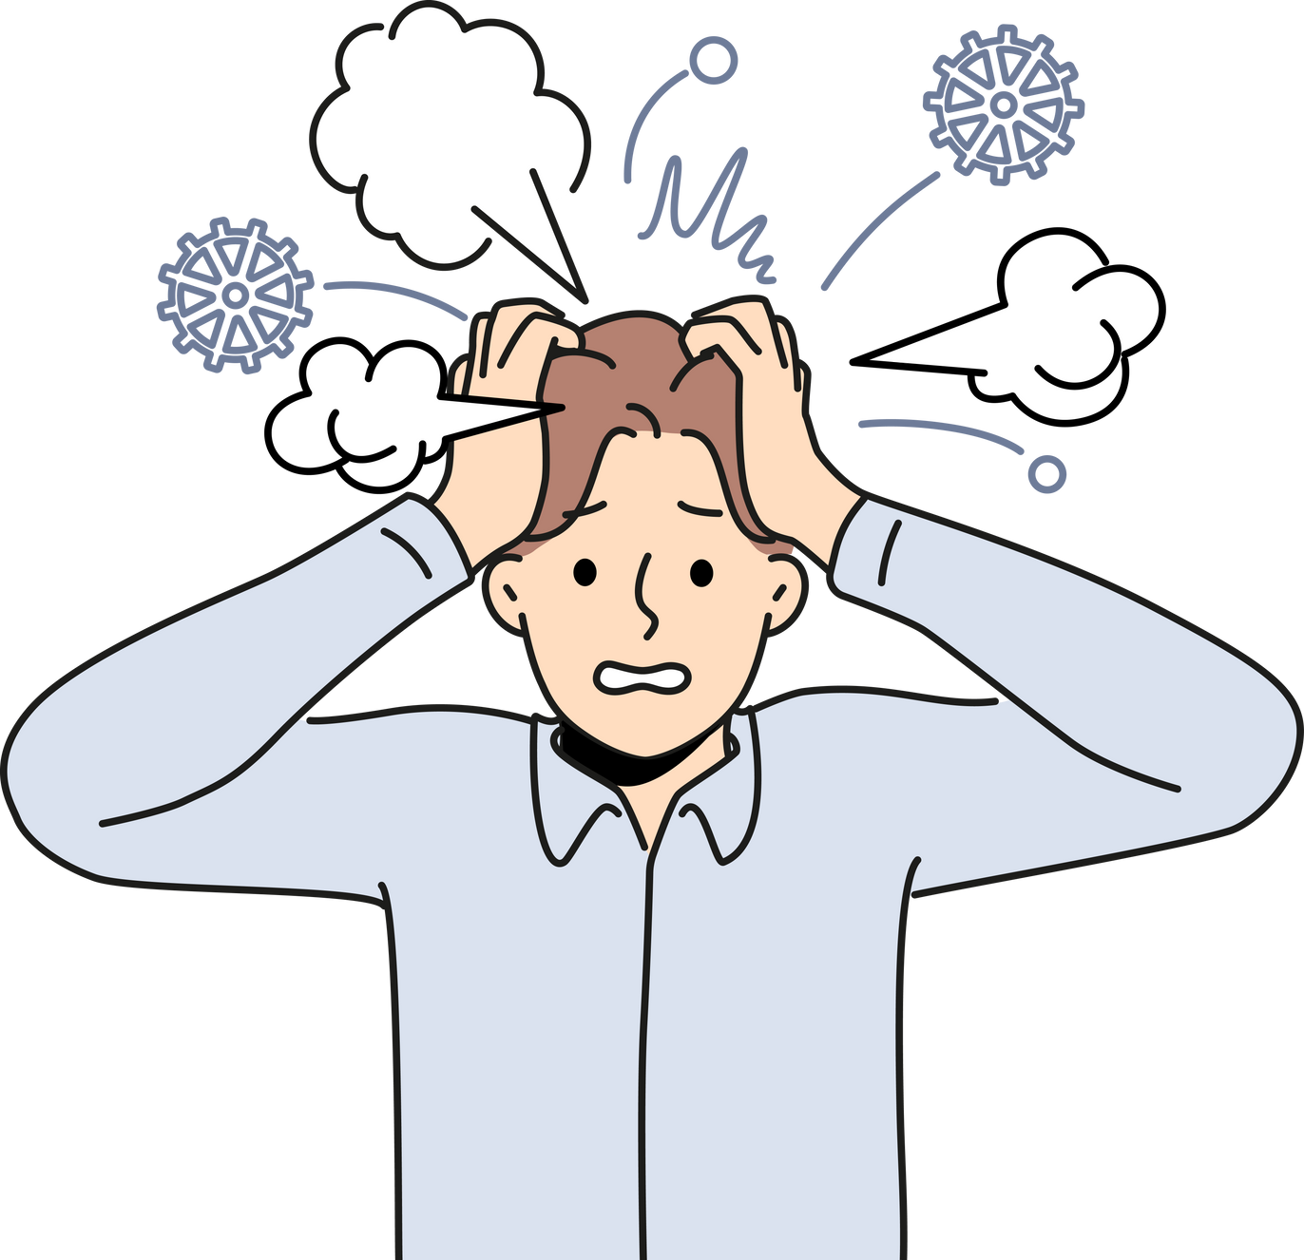
Problem statement
double bounce notice
referee human errors
Fans & players pressure
hitting the floor twice
dizzinies, anxiety and others
fans can be leverage

Slide 6


similar system
A Computer Vision driven Squash Players Tracking System
Real Time Object Detection, Tracking, and Distance and Motion Estimation
based on Deep Learning: Application to Smart Mobility
Detection and Tracking of a Fast-Moving Object in Squash
using a Low-Cost Approach

Slide 7
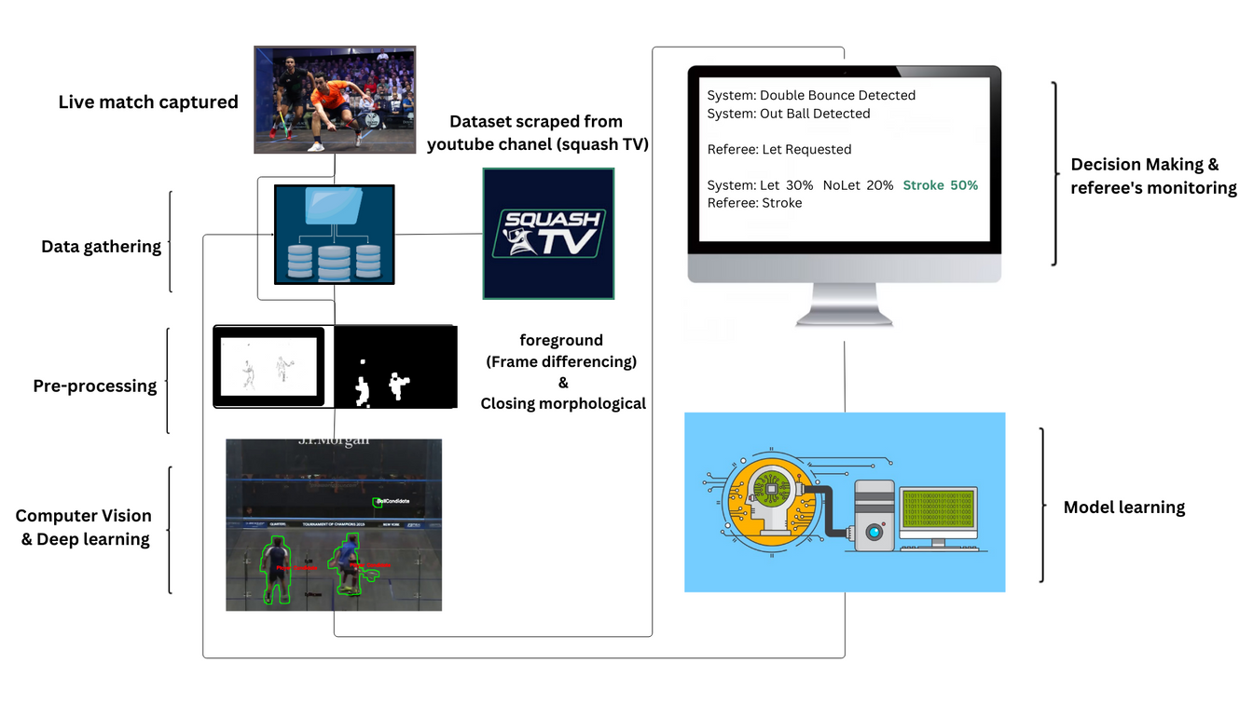
system Overview
Data Input
Decision making & referee’s monitoring
• Data Gathering
model learning
Pre-Processing
Computer Vision & Deep Learning

Slide 8
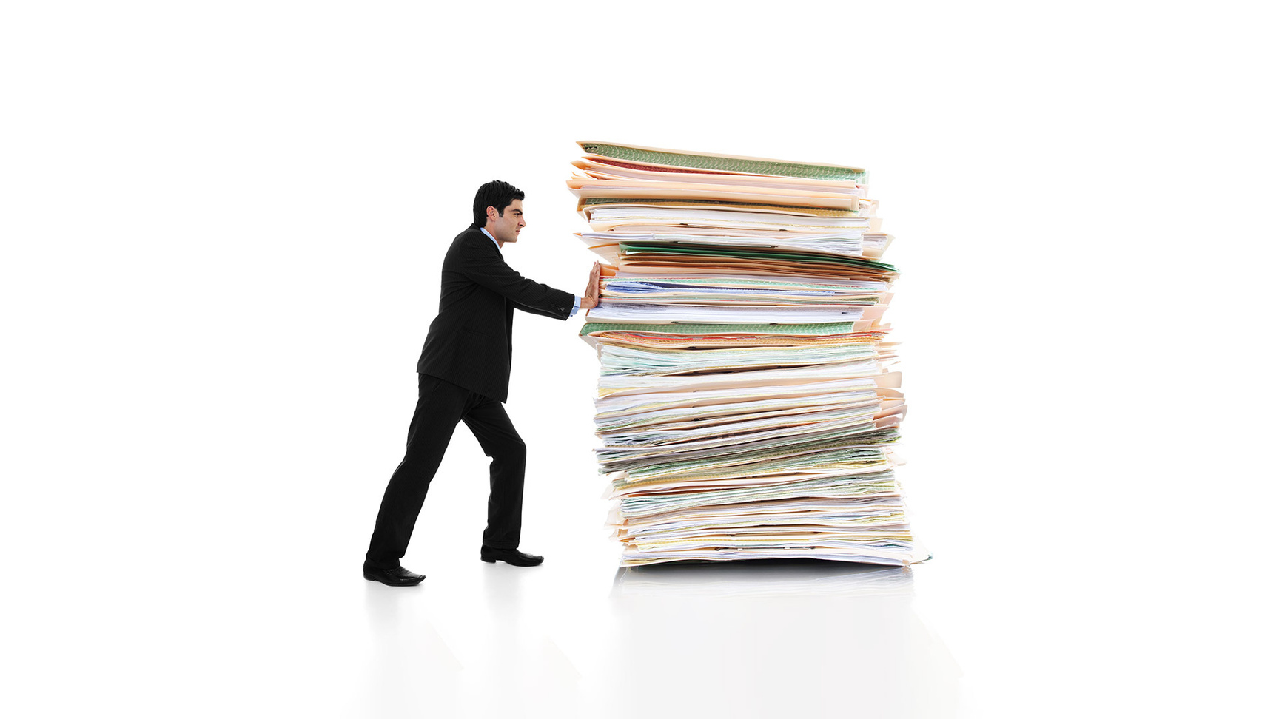
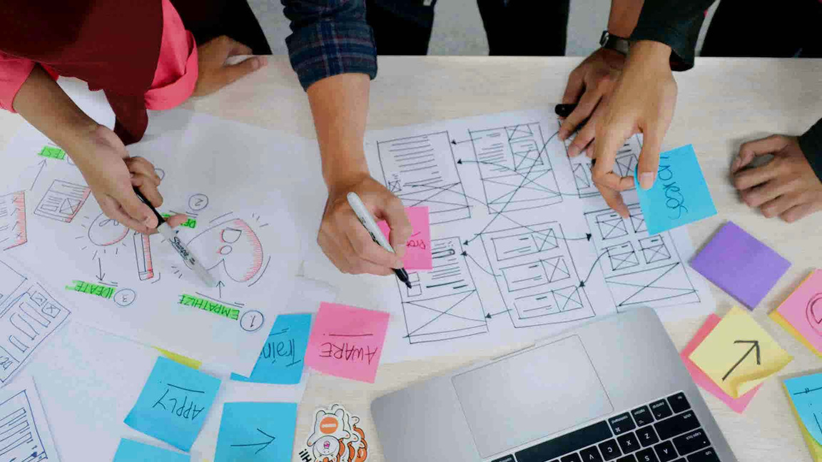


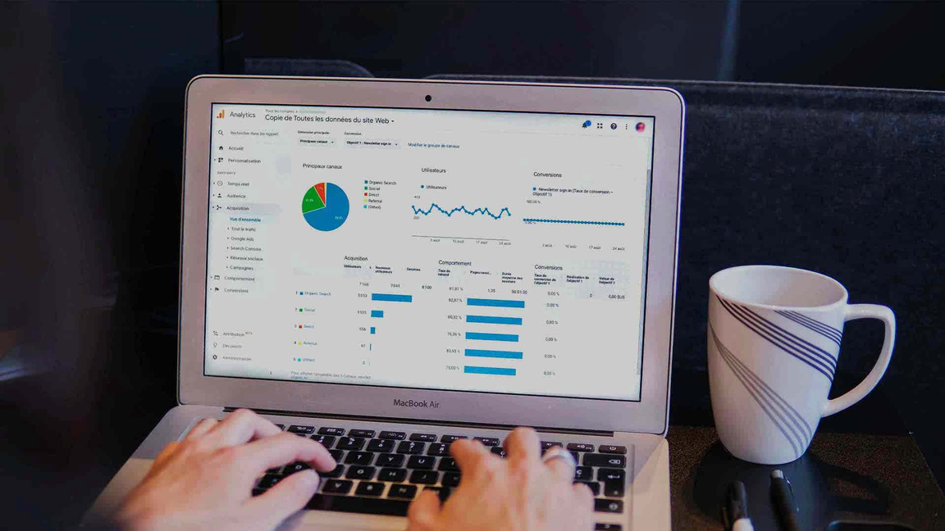

deleiverable
Software proposal document
Software Design Description
(SDD) Document
software requiremnts sheet
Thesis statement
Research and Academic Papers
Desktop Application

Slide 9
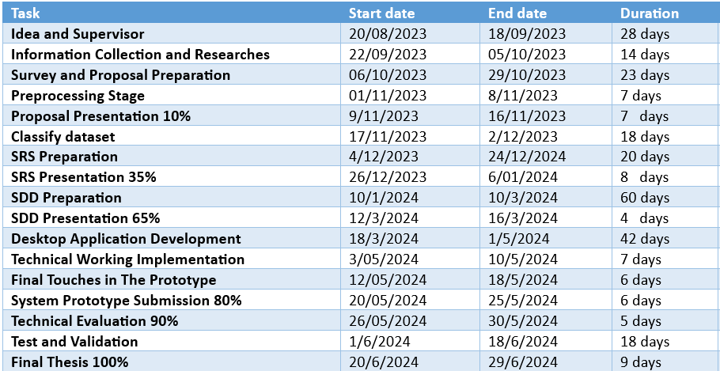
Timeplan

Slide 10

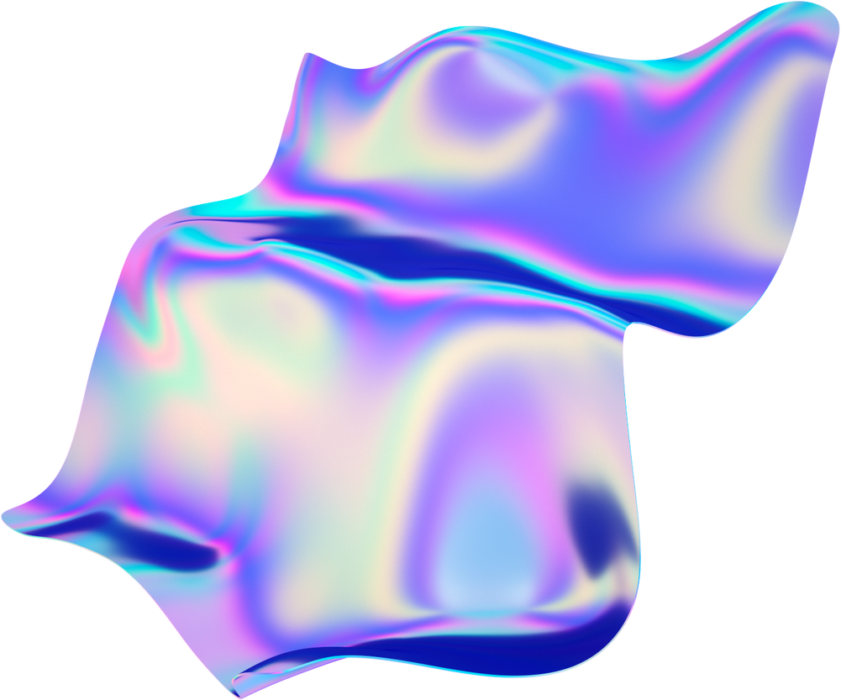

challenge and solutions
Lack of ready made datasets
Database size used to support this system.
Real time processing is not easy.
The used cameras does not meet the specs that we need.
Multi camera, single decision.
This idea has not been proposed before.
Scrapped youtube & WSO videos.
MongoDB & Google Cloud Storage.
High processor with optimizations & high RAMs.
60 frames per seconds or above cameras.
NTP sync. ,Cameras calibration and decision-making algorithm that fuses data from all cameras.
Thus the limited literature and uncertain methodologies requires resilience, creativity, and effective
problem-solving.

Slide 11

supportive documents
Dataset
SQUASHTV youtube channel
world squash officiating
Survey Charts
&
Pro Players Interview

Slide 12
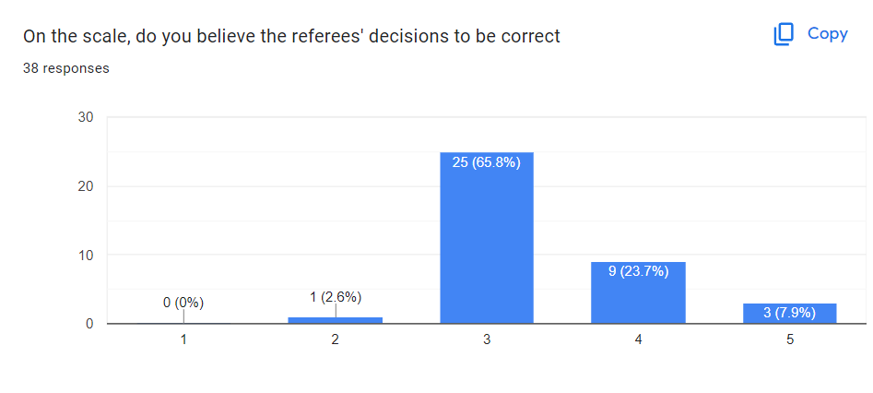
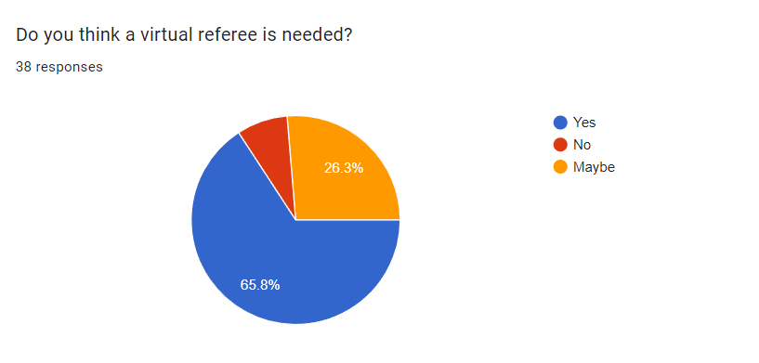
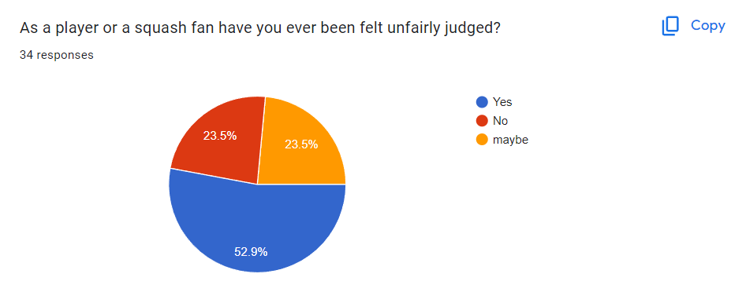
Survey Charts

Slide 13
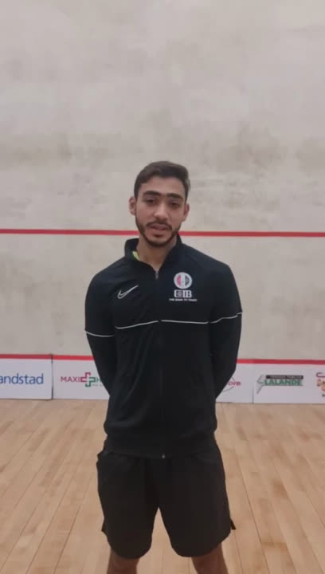
Pro Players interview

Slide 14
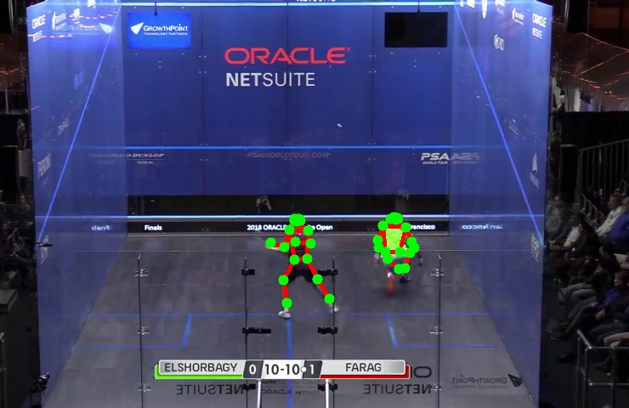
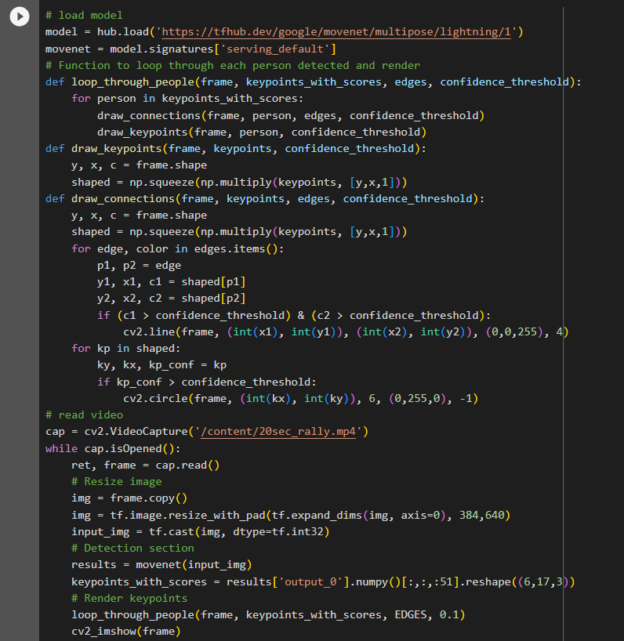
DEMOS

Slide 15
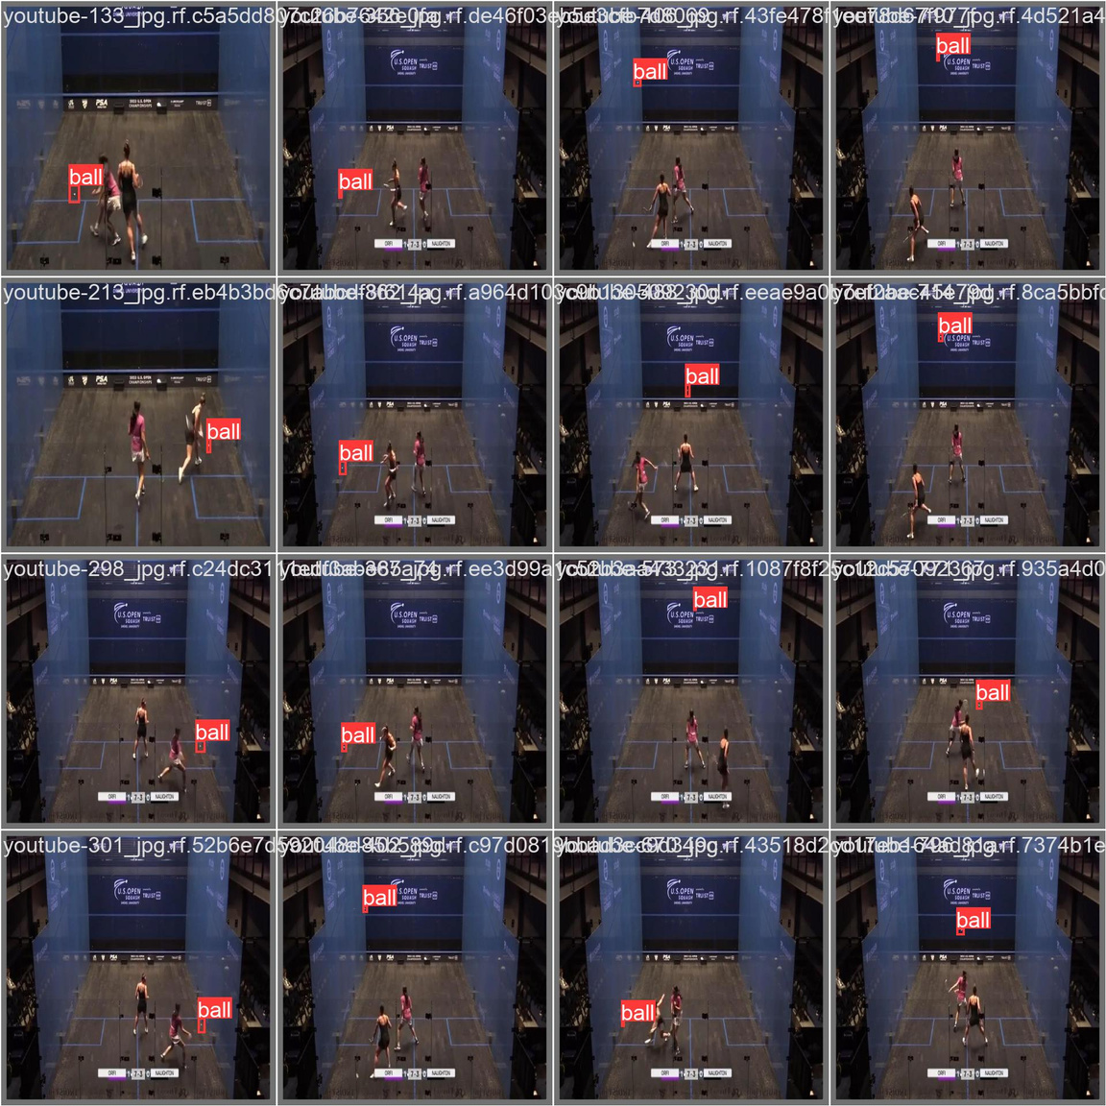
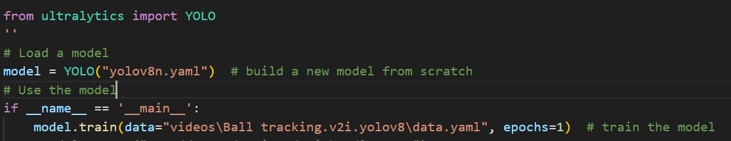
DEMOS

Slide 16
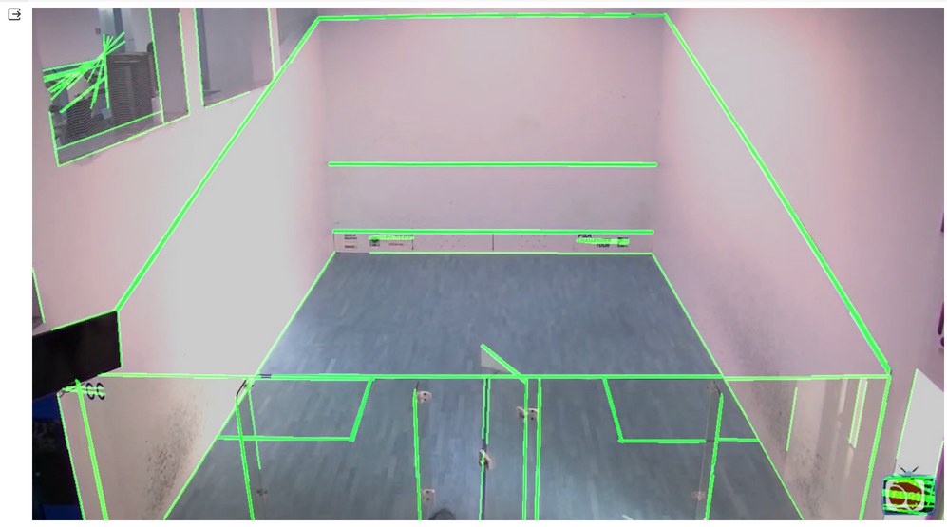
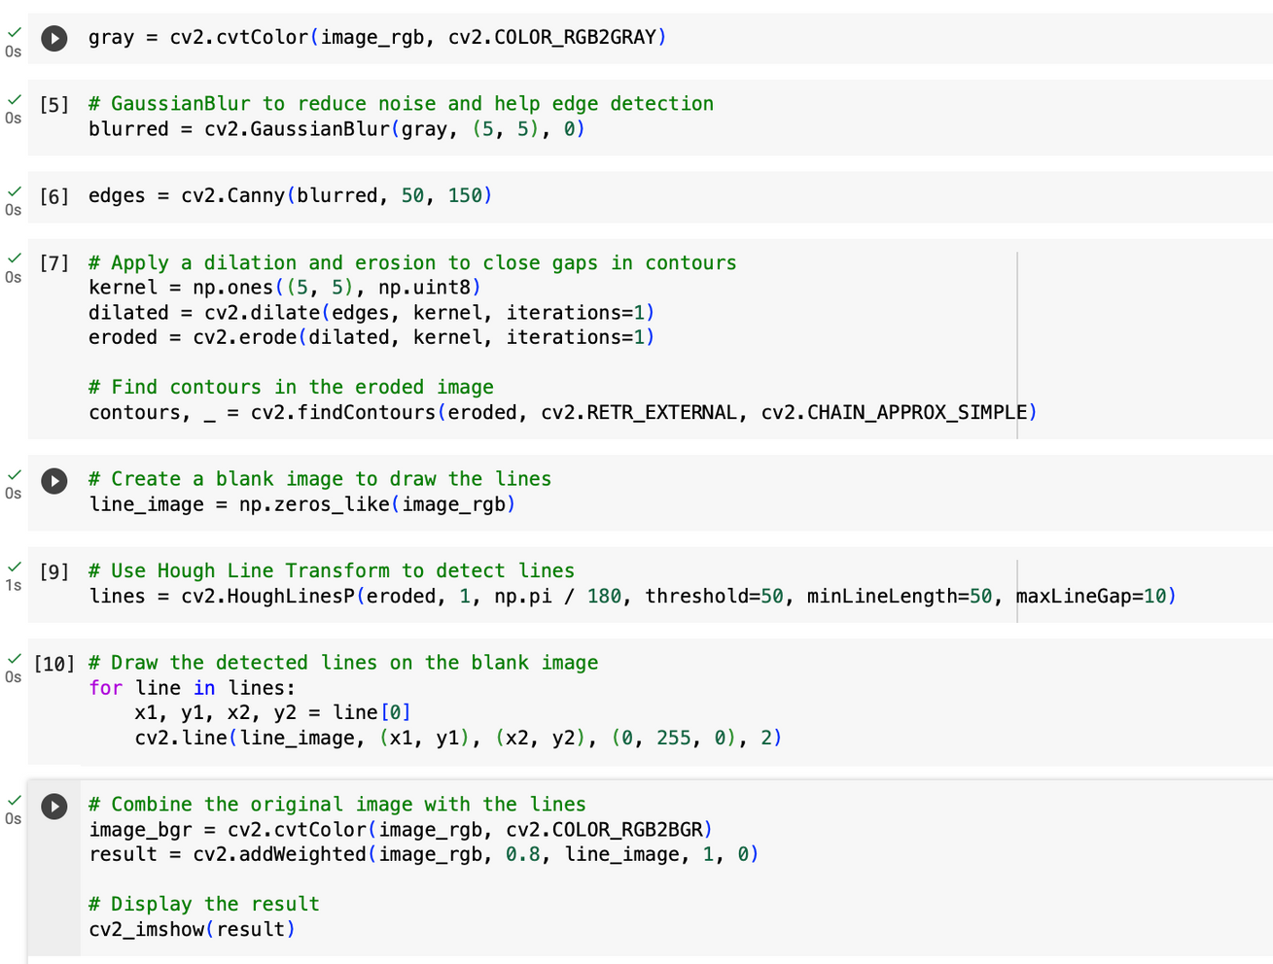
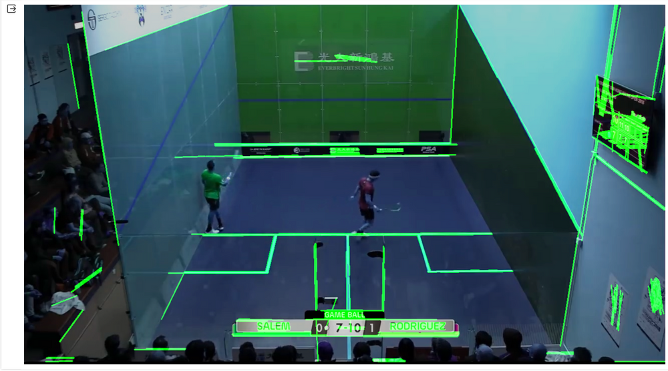
DEMOS

Slide 17

Thank You

